Slide 1

STEM
Test cases

Slide 2
Agenda
Introduction (Seppe)
Test cases (Bruno)
“Rules“
Test cases
How to run the analysis and commit the results
STEM base case description (Aron)
Example calculation
Planning
Discussion / Hands-on / …

Slide 3
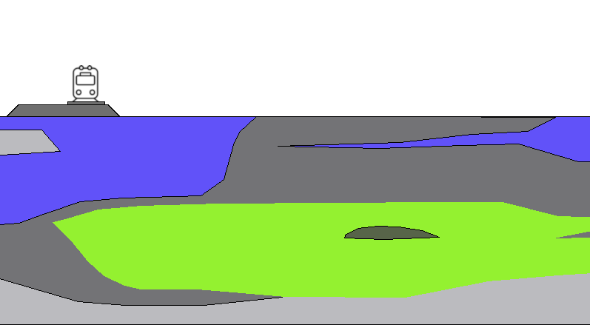

STEM test cases
Get acquainted with and explore STEM concepts
Understand input and output processes
Perform a realistic calculation with STEM
Test assumptions and apply mitigation strategies
Train-track-interaction model
API
STEM
model
Time dependency model
ballast & subsoil
API
API
Subsoil schematisation model taking into account characterisation

Slide 4
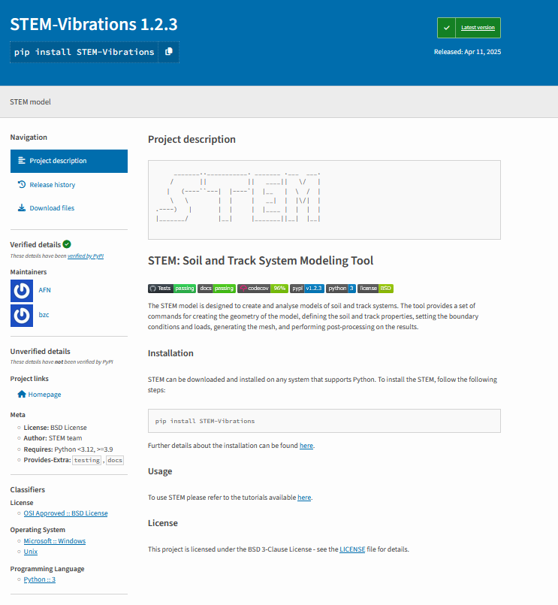
STEM test cases ”Rules”
STEM version 1.2.3
pip install STEM-Vibrations
Use the base python model, default mesh and solver settings as provided here
All the results are to be shared in STEM test cases
All the results are automatically displayed in STEM test cases page
Before commiting the results to the repository read the instructions
Recommendations:
You need to have git and an account
You need to have Python installed
Use a virtual environment (Python 3.9, 3.10, 3.11)
Computer with at least 16GB of RAM

Slide 5

STEM test cases Cases
Soft subsurface: based on Schalkwijk
Stiff subsurface: based on Holten

Slide 6
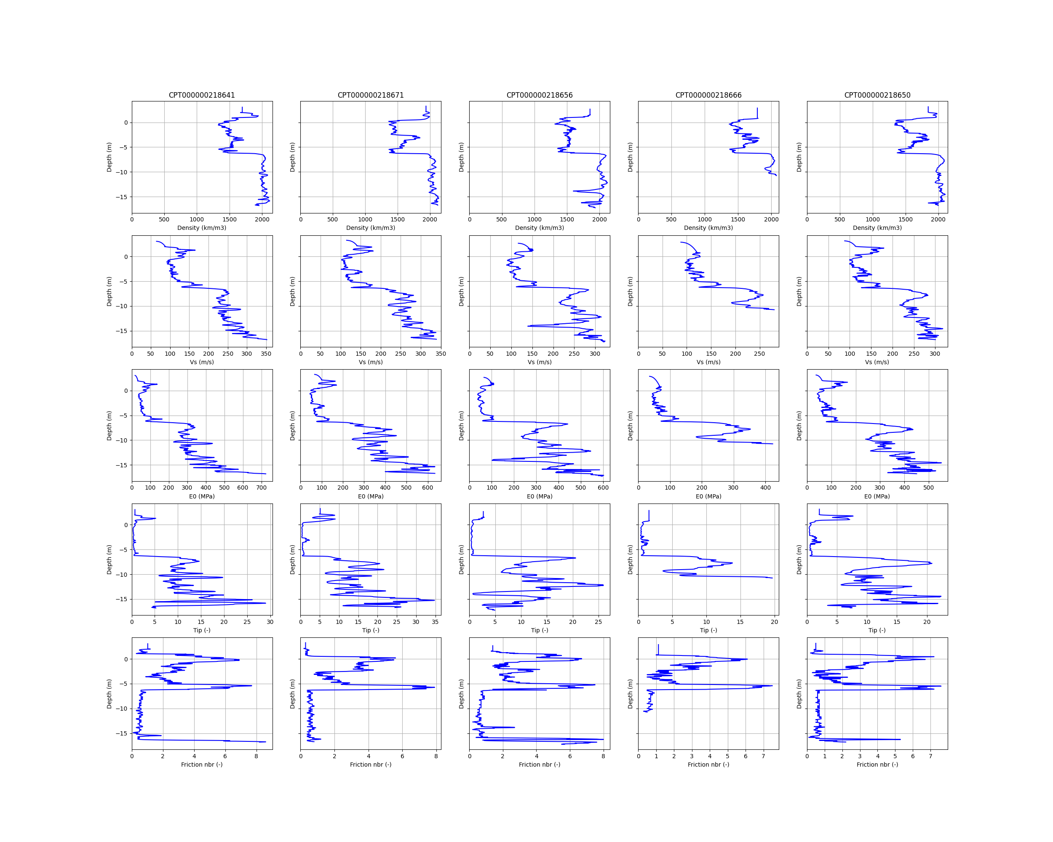
STEM test cases Cases
Soft subsurface: based on Schalkwijk
Subsurface processed using Robertson

Slide 7
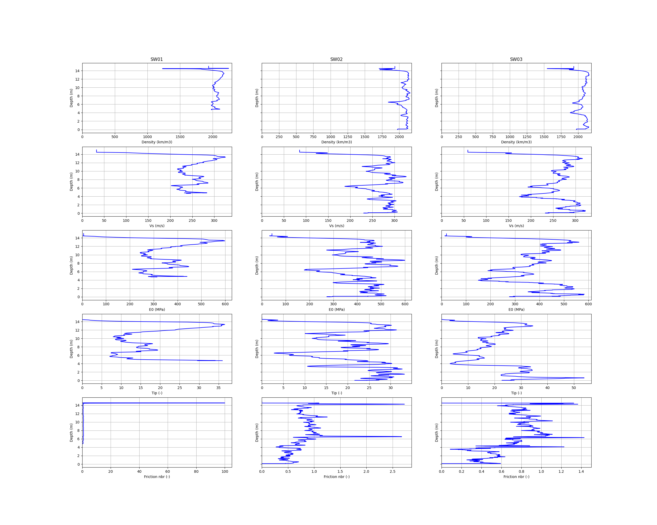
STEM test cases Cases
Soft subsurface: based on Holten
Subsurface processed using Robertson
Stiff subsurface: based on Schalkwijk

Slide 8
STEM test cases Cases
Test number | Test description | How to model in STEM | Stiff case | Soft case | Who (tentative)
1 | Stiffnening of the rail | Change the stiffness of the rail element by a factor 2 | ü | ü | WeBoost - Rienk
2 | Concrete slab under the ballast | Change the material properties | ü | ü | Cohere – Sjoerd
3 | Composite sleepers | Change the mass of the sleepers | ü | ü | Cohere – Sjoerd
4 | Geometry of the embankment | Change the coordinates of the embankment point |  | ü | Movares – Patrick
5 | Deepwall (diepwand) of EPS | Change the material properties |  | ü | W+B – Janno
6 | Effect of the primary suspension parameters | Change the train primary stiffness by a factor 2 | ü | ü | Ricardo – Thomas
7 | Effect of soil properties | Change the top layer Young modulus by a factor 2 | ü | ü | M+P – Marc
8 | Effect of rail roughness | Change the Av factor by a factor 10 | ü | ü | Level – Arnold
9 | Effect of train speed | Change the speed to 160 / 3.6 m/s and calculation time | ü | ü | Cauberg – Gerard
10 | Comparison between rail types E54 and E60 | Change rail type | ü | ü | ProRail – Kareen
11 | PSS soil layer | Change the material properties | ü | ü | ProRail – Seppe
12 | Under sleeper pads | Change the stiffness and damping of the railpad | ü | ü | ProRail – Niels
13 | Effect of water ditch | Change the material properties |  | ü | ProRail – Hielke
14 | Effect of ballast stiffness | Change the Young modulus by a factor 2 | ü | ü | Dawn
15 | Effect of embankment stiffness | Change the Young modulus by a factor 2 |  | ü | TNO – Elham
16 | Effect of Rayleigh damping | Change the damping stiffness parameter to 0.000104 | ü | ü | Level – Arnold
17 | Effect of secondary suspension parameters | Change the train secondary stiffness by a factor 2 | ü | ü | TNO – Elham
18 | Train vs moving loads | Change the UVEC train to moving loads | ü | ü | Arcadis – Otto
19 | Effect of the unsprung mass | Change the whell mass by a factor of two | ü | ü | ProRail – Peter
20 | Effect of layering | Change the coordinates of the layers |  | ü | WeBoost - Rienk
21 | Combine 2 & 19 | Change parameters | ü | ü | Level – Arnold

Slide 9
STEM test cases How to run the results
Check-out the STEM test cases repository:
git clone https://github.com/StemVibrations/TestCases.git
cd TestCases
In the folder inputs you have these files:
soft_soil.py
stiff_soil.py
example_yaml.yaml
Edit the STEM files according to you test case
Run the STEM models (for this you need to have STEM installed). The results are:
Json file with the displacement, velocity and acceleration at a specific node
(optional) the VTK file to visualise the results in paraview (to do this you need to install paraview)

Slide 10
STEM test cases How to commit the results
Prepare for each test case an unique yaml file, with an unique filename.
This yaml file must follow this structure:
organisation: Deltares
title: Test 1
test-description: >
This is the file for test 1
date: 2025-06-23
json-file: json_results_file.json # name of the json output file generated by STEM
input-file: python_input_file.py # name of the STEM input file
mdpa-file: mdpa_file.mdpa # name of the MDPA file generated by STEM
STEM-version: 1.2.3
Please validate the yaml file before commiting.
The calculation is run in two stages: 1st stage static initialisation; 2nd stage dynamic loading.
Please only commit the json and mdpa files of the 2nd stage

Slide 11
STEM test cases How to commit the results
Create a branch with the name of the test:
git checkout –b test_case_number
Place the input file, json results file, and yaml files in the data folder (please give to all these files the case number name, e.g. case_1_soft.py, case_1_results_soft.json, case_1_soft.yaml).
Add the files to the branch you created
git add data/ case_1_soft.yaml data/case_1_results_soft.json data/case_1_soft.py
git commit -m "Add test case number"
git push origin test_case_number

Slide 12
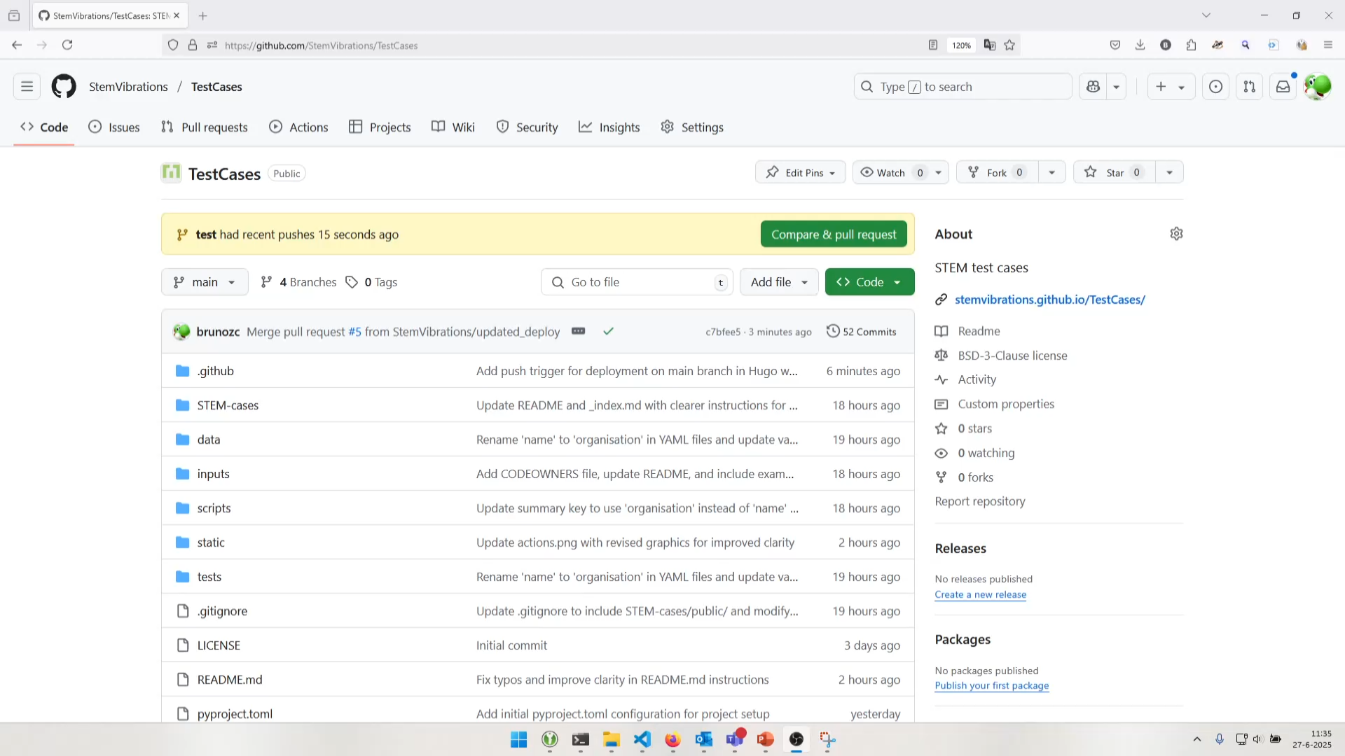
STEM test cases How to commit the results
Create a Pull Request:
branch test
wait for the tests to pass
We only review/accept PRs that are passing

Slide 13
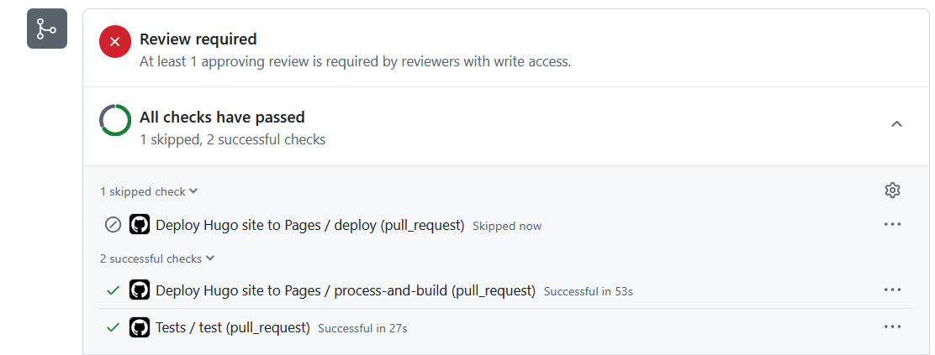
STEM test cases How to commit the results
Create a Pull Request:

Slide 14
STEM test cases How to commit the results
Visualise the results
https://stemvibrations.github.io/TestCases/
Note:
In order to create a PR you need to have a github account. And you need to be added to the TestCases project. So please share your github username with us.

Slide 15
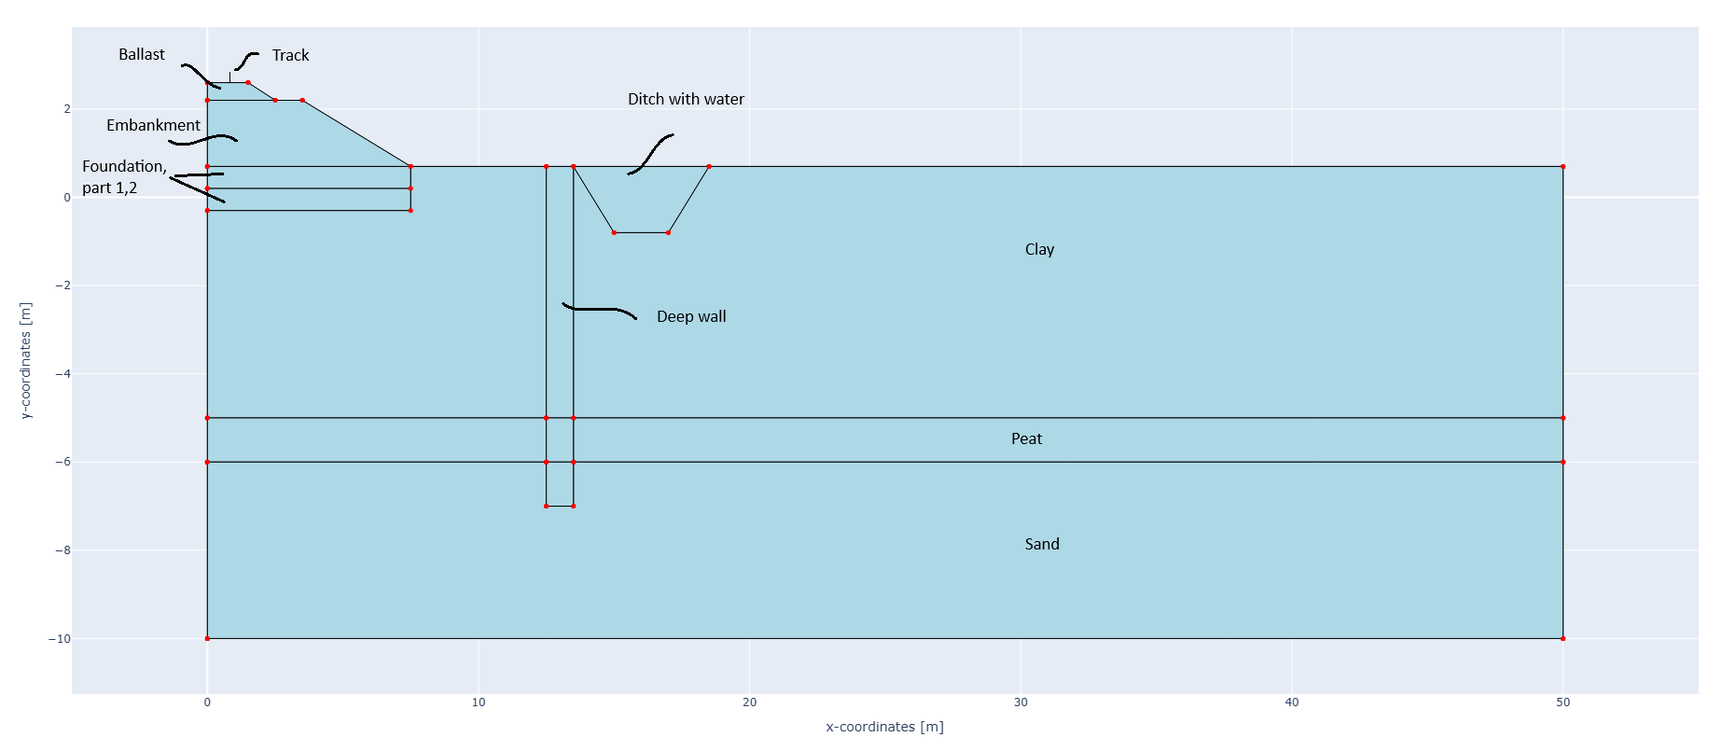
STEM base case description soft case

Slide 16
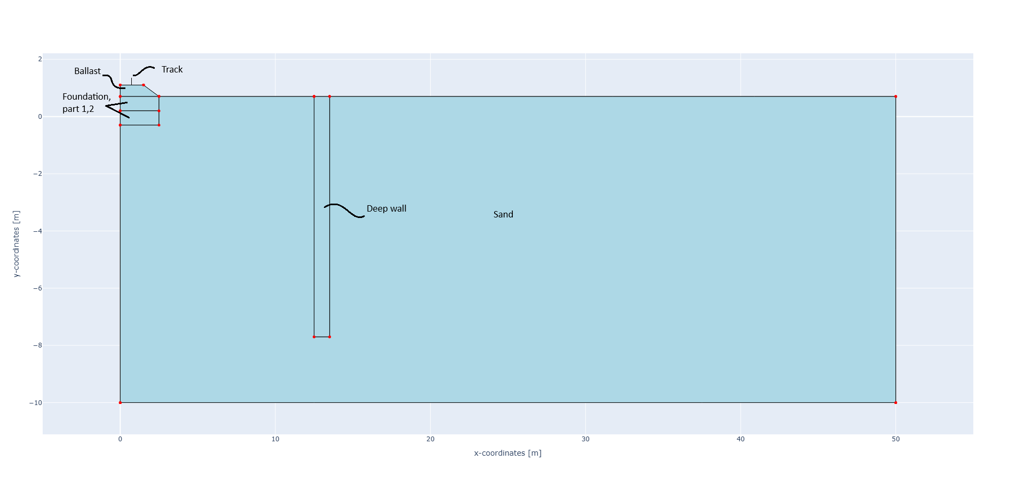
STEM base case description stiff case

Slide 17
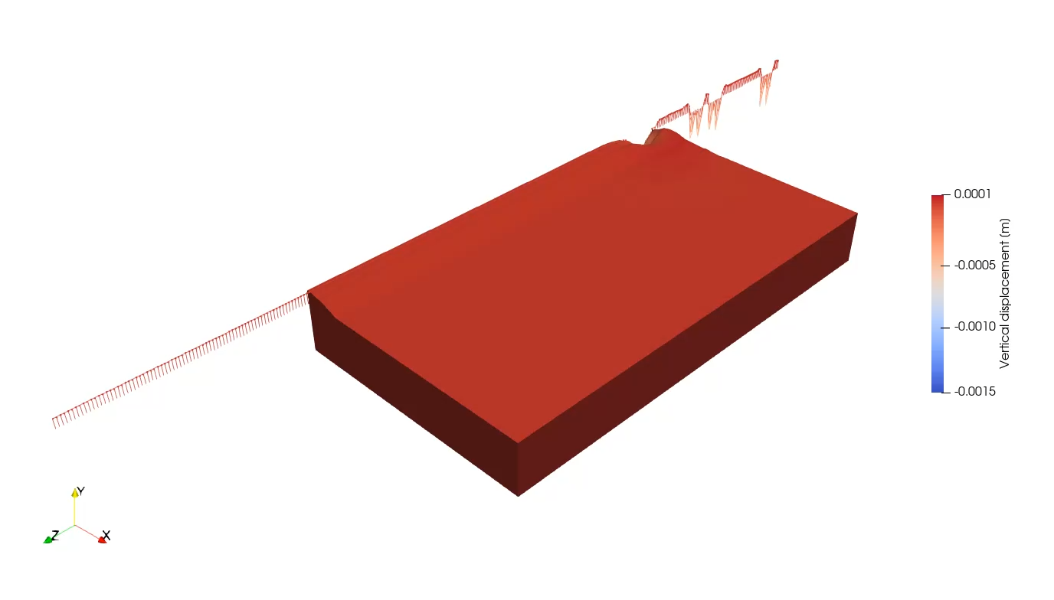
STEM results Soft subsurface

Slide 18
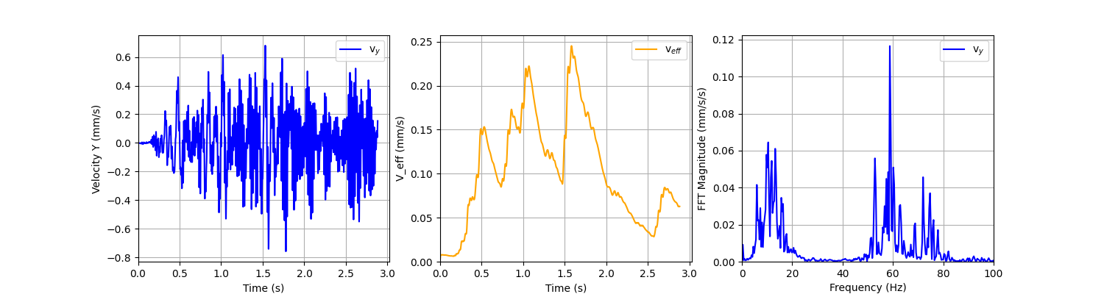
STEM results Soft subsurface

Slide 19
Planning
Today: Start-up
We found an issue with convergency.
We will update the project files this week and communicate it
Upload results (before end of August)
End of September: Discussion of the results

Slide 20
Discussion / Hands-on / …
…

Slide 21

What is the STEM model
Train-track-interaction model
STEM packages:
STEM
gmsh utils (geometry & mesher)
Vehicle models
Random fields
Kratos (FEM)
Python package
https://pypi.org/project/STEM-Vibrations
https://stemvibrations.readthedocs.io
https://github.com/StemVibrations/STEM
API
STEM
model
Time dependency model
ballast & subsoil
API
API
Subsoil schematisation model taking into account characterisation

Slide 22
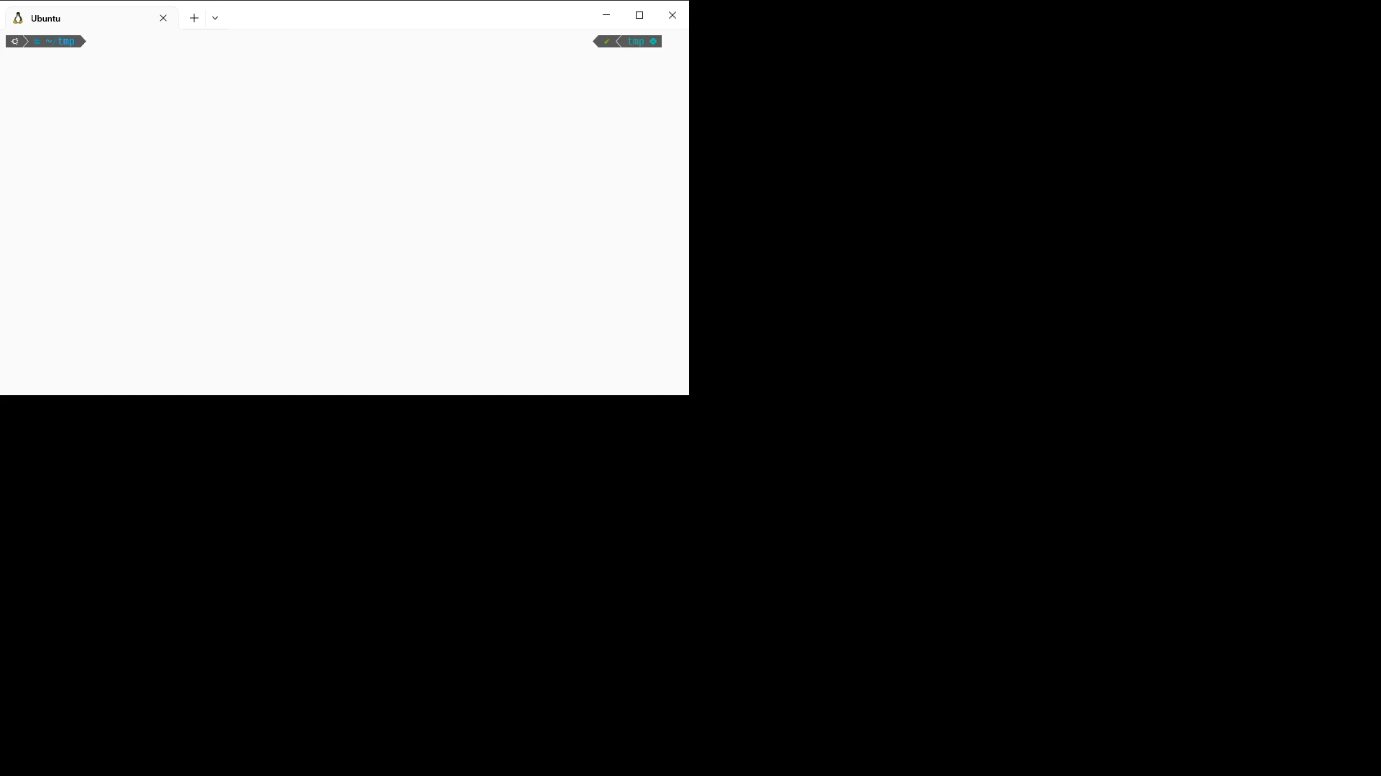
What is the STEM model Installation
/> pip install STEM-Vibrations (inside a virtual environment)
The official version: v1.2

